Slide 1
مدیریت پروژه های فناوری اطلاعات
دانشکده مهندسی کامپیوتر و فناوری اطلاعات
رشته مهندسی فناوری اطلاعات
دوره کارشناسی

Slide 2

Chapter 1: Introduction to Project Management
Information Technology Project Management, Seventh Edition
Note: See the text itself for full citations.

Slide 3
Learning Objectives
Understand the growing need for better project management, especially for information technology (IT) projects
Explain what a project is, provide examples of IT projects, list various attributes of projects, and describe the triple constraint of project management
Describe project management and discuss key elements of the project management framework, including project stakeholders, the project management knowledge areas, common tools and techniques, and project success

Slide 4
Learning Objectives
Discuss the relationship between project, program, and portfolio management and the contributions each makes to enterprise success
Understand the role of project managers by describing what they do, what skills they need, and career opportunities for IT project managers
Describe the project management profession, including its history, the role of professional organizations like the Project Management Institute (PMI), the importance of certification and ethics, and the advancement of project management software

Slide 5
Introduction
Many organizations today have a new or renewed interest in project management
Computer hardware, software, networks, and the use of interdisciplinary and global work teams have radically changed the work environment
The world as a whole spends nearly $10 trillion of its $40.7 trillion gross product on projects of all kinds
More than 16 million people regard project management as their profession

Slide 6
Project Management Statistics
The overall information and communications technology market grew by 6 percent to almost $3 trillion in 2010
In the U.S. the size of the IT workforce topped 4 million workers in 2008, and the unemployment rate for IT professionals is half the rate for the overall labor market
In 2011 the total compensation for the average senior project manager in U.S. dollars was $105,000 per year in the United States and $160,409 in the Switzerland.
The number of people earning their Project Management Professional (PMP) certification continues to increase. 44 percent of employers listed project management as a skill they looked for in new college grads, behind only communication and technical skills

Slide 7
Motivation for Studying Information Technology (IT) Project Management
IT Projects have a terrible track record, as described in the What Went Wrong?
A 1995 Standish Group study (CHAOS) found that only 16.2% of IT projects were successful in meeting scope, time, and cost goals; over 31% of IT projects were canceled before completion
A PricewaterhouseCoopers study found that overall half of all projects fail and only 2.5% of corporations consistently meet their targets for scope, time, and cost goals for all types of project.

Slide 8
Advantages of Using Formal Project Management
Better control of financial, physical, and human resources
Improved customer relations
Shorter development times
Lower costs
Higher quality and increased reliability
Higher profit margins
Improved productivity
Better internal coordination
Higher worker morale

Slide 9
What Is a Project?
A project is “a temporary endeavor undertaken to create a unique product, service, or result” (PMBOK® Guide, Fifth Edition, 2012)
Operations is work done to sustain the business
Projects end when their objectives have been reached or the project has been terminated
Projects can be large or small and take a short or long time to complete

Slide 10
Examples of IT Projects
A team of students creates a smartphone application and sells it online
A company develops a driverless car
A small software development team adds a new feature to an internal software application for the finance department
A college upgrades its technology infrastructure to provide wireless Internet access across the whole campus

Slide 11
Top Strategic Technologies for 2012 (Gartner)
Media tablets and beyond
Mobile-centric applications and interfaces
Contextual and social user experience
Internet of things
Cloud computing

Slide 12
Media Snapshot: Unproductive Apps
Gartner predicts that by 2014, there will be more than 70 billion mobile application downloads every year
All of the top iPhone apps in early 2012 (Temple Run, Angry Gran, Zombie Farm, Words With Friends, Angry Birds, etc.) and most of the top iPad2 apps can be considered unproductive in most work environments
The challenge is to develop useful apps and get workers to focus on them instead of the many distracting options available

Slide 13
Project Attributes
A project
has a unique purpose
is temporary
is developed using progressive elaboration
requires resources, often from various areas
should have a primary customer or sponsor
The project sponsor usually provides the direction and funding for the project
involves uncertainty

Slide 14
Project and Program Managers
Project managers work with project sponsors, project team, and other people involved in a project to meet project goals
Program: group of related projects managed in a coordinated way to obtain benefits and control not available from managing them individually (PMBOK® Guide, Fifth Edition, 2012)
Program managers oversee programs; often act as bosses for project managers

Slide 15
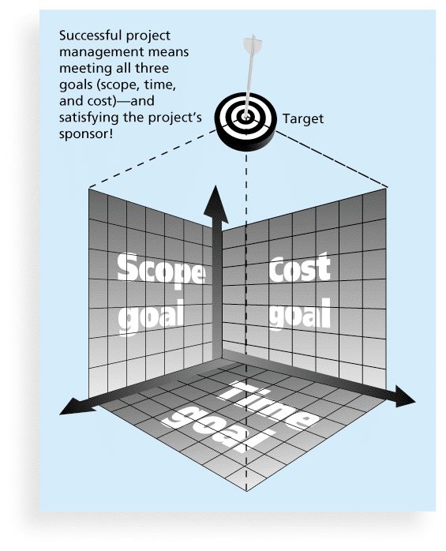
Figure 1-1 The Triple Constraint of Project Management

Slide 16
What is Project Management?
Project management is “the application of knowledge, skills, tools and techniques to project activities to meet project requirements” (PMBOK® Guide, Fourth Edition, 2012)
Project managers strive to meet the triple constraint (project scope, time, and cost goals) and also facilitate the entire process to meet the needs and expectations of project stakeholders

Slide 17
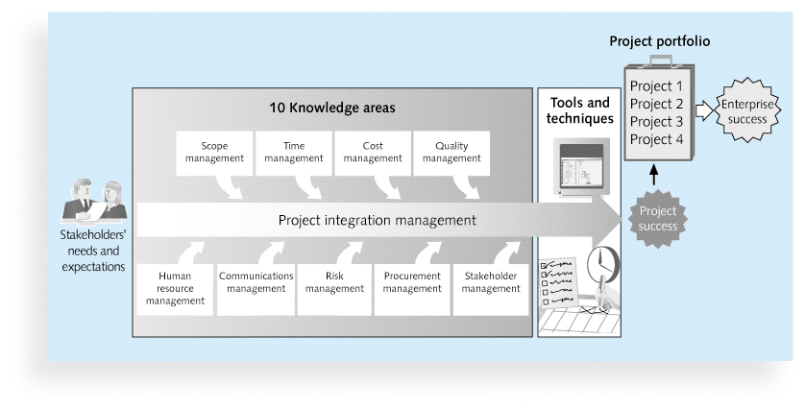
Figure 1-2 Project Management Framework

Slide 18
Project Stakeholders
Stakeholders are the people involved in or affected by project activities
Stakeholders include
the project sponsor
the project manager
the project team
support staff
customers
users
suppliers
opponents to the project

Slide 19
10 Project Management Knowledge Areas
Knowledge areas describe the key competencies that project managers must develop
Project managers must have knowledge and skills in all 10 knowledge areas (project integration, scope, time, cost, quality, human resource, communications, risk, procurement, and stakeholder management)
This text includes an entire chapter on each knowledge area

Slide 20
Project Management Tools and Techniques
Project management tools and techniques assist project managers and their teams in various aspects of project management
Some specific ones include
Project charter, scope statement, and WBS (scope)
Gantt charts, network diagrams, critical path analysis, critical chain scheduling (time)
Cost estimates and earned value management (cost)
See Table 1-1 for many more

Slide 21
Super Tools
“Super tools” are those tools that have high use and high potential for improving project success, such as:
Software for task scheduling (such as project management software)
Scope statements
Requirements analyses
Lessons-learned reports
Tools already extensively used that have been found to improve project importance include:
Progress reports
Kick-off meetings
Gantt charts
Change requests

Slide 22
What Went Right? Improved Project Performance
The Standish Group’s CHAOS studies show improvements in IT projects in the past decade:
The number of successful IT projects has more than doubled, from 16 percent in 1994 to 37 percent in 2010
The number of failed projects decreased from 31 percent in 1994 to 21 percent in 2010
Success rates were the highest ever in the most recent CHAOS study

Slide 23
Why the Improvements?
"The reasons for the increase in successful projects vary. First, the average cost of a project has been more than cut in half. Better tools have been created to monitor and control progress and better skilled project managers with better management processes are being used. The fact that there are processes is significant in itself.”*
*Standish Group, "CHAOS 2001: A Recipe for Success" (2001).

Slide 24
Project Success
There are several ways to define project success:
The project met scope, time, and cost goals
The project satisfied the customer/sponsor
The results of the project met its main objective, such as making or saving a certain amount of money, providing a good return on investment, or simply making the sponsors happy

Slide 25
Table 1-2: What Helps Projects Succeed?*
1. User involvement
2. Executive support
3. Clear business objectives
4. Emotional maturity
5. Optimizing scope
6. Agile process
7. Project management expertise
8. Skilled resources
9. Execution
10. Tools and infrastructure
*The Standish Group, “CHAOS Activity News” (August 2011).

Slide 26
Top Three Reasons Why Federal Technology Project Succeed
Adequate funding
Staff expertise
Engagement from all stakeholders

Slide 27
What the Winners Do…
Recent research findings show that companies that excel in project delivery capability:
Use an integrated project management toolbox (use standard/advanced PM tools, lots of templates)
Grow project leaders, emphasizing business and soft skills
Develop a streamlined project delivery process
Measure project health using metrics, like customer satisfaction or return on investment

